Slide 1


Automated Grading: Transforming Evaluation
In the ever-evolving landscape of education, the process of evaluating student performance has undergone a significant transformation. Introducing an automated grading system powered by artificial intelligence and machine learning can revolutionize the way faculty approach assessment, making it more efficient, objective, and insightful. This comprehensive solution aims to streamline the grading process, providing faculty with a reliable and data-driven approach to evaluating student responses across various question formats.

Slide 2
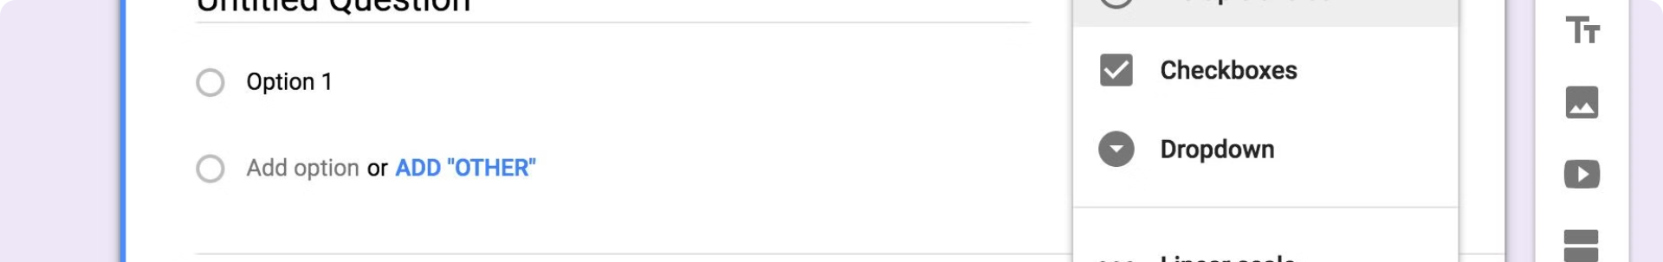
Dummy Question Paper: Simulating Reality
Multiple Choice Questions
Descriptive Questions
Coding Question
The dummy question paper includes 5 multiple-choice questions, each worth 1 mark. Faculty can easily input the correct answers, and the system will automatically compare the student's responses for accurate grading.
The paper also features 5 descriptive questions, each worth 2 marks. These open-ended questions will be evaluated using a pre-trained BERT model, which analyzes the content and provides a detailed assessment of the student's response.
Additionally, the question paper includes a coding question worth 10 marks. Students can upload their Java code, which will be executed and compared to the expected output provided by the faculty. The system will assess the code quality and output similarity, allocating marks accordingly.

Slide 3
Empowering Data-Driven Insights
Dummy Student Responses
Performance Evaluation
Data-Driven Insights
To ensure the effectiveness of the automated grading system, the solution incorporates a dataset of dummy student responses. These responses, generated using Artificial Intelligence (Chat GPT 4.0 Model), closely mimic real-world scenarios and provide a comprehensive test case for the grading algorithm.
The system will analyze the dummy student responses, evaluating the accuracy and effectiveness of the grading algorithms across the various question types. This comprehensive analysis will help faculty refine the grading process and ensure a robust and reliable assessment framework.
The automated grading system will generate detailed performance reports, providing faculty with data-driven insights into student strengths, weaknesses, and areas for improvement. These insights can inform instructional strategies and help faculty better support student learning and development.

Slide 4
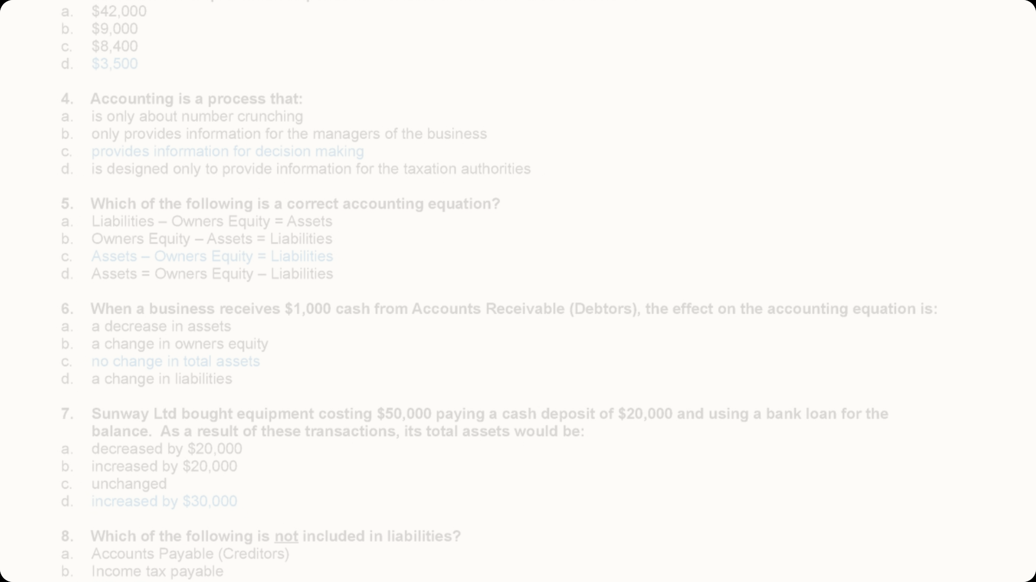
Evaluating Multiple Choice Questions
1
Faculty Input
2
Automated Comparison
3
Objective Grading
For the multiple-choice questions, faculty will need to provide the correct answers, which can be copied and pasted directly from the options.
This straightforward approach ensures an objective and consistent grading process, eliminating the potential for human error or bias.
The system will then automatically compare the student's selected options with the faculty-provided answers, allocating the appropriate marks based on the exact match.

Slide 5

Empowering Descriptive Responses
Pre-trained BERT Model
The system utilizes a pre-trained BERT (Bidirectional Encoder Representations from Transformers) model, which has been fine-tuned on a comprehensive corpus of Java-related content from reliable sources, such as RGUKT, Nuzvid, and leading Java textbooks.
Detailed Evaluation
Based on the BERT model's analysis, the system will provide a detailed assessment of the student's response, allocating marks out of the 2 points assigned to each descriptive question.
1
2
3
Contextual Understanding
The BERT model's deep understanding of the Java domain allows it to accurately assess the student's descriptive responses, evaluating the content, coherence, and relevance to the questions asked.

Slide 6




Evaluating Coding Submissions
Code Submission
Code Analysis
Output Comparison
Detailed Feedback
Students can upload their Java code files directly to the system, which will then analyze the submitted code.
The system will evaluate the code quality, considering factors such as code structure, syntax, and programming best practices.
Based on the code analysis and output comparison, the system will allocate marks and provide detailed feedback to the student, highlighting areas for improvement.
The system will execute the student's code and compare the output with the expected output provided by the faculty, assessing the similarity and accuracy.

Slide 7
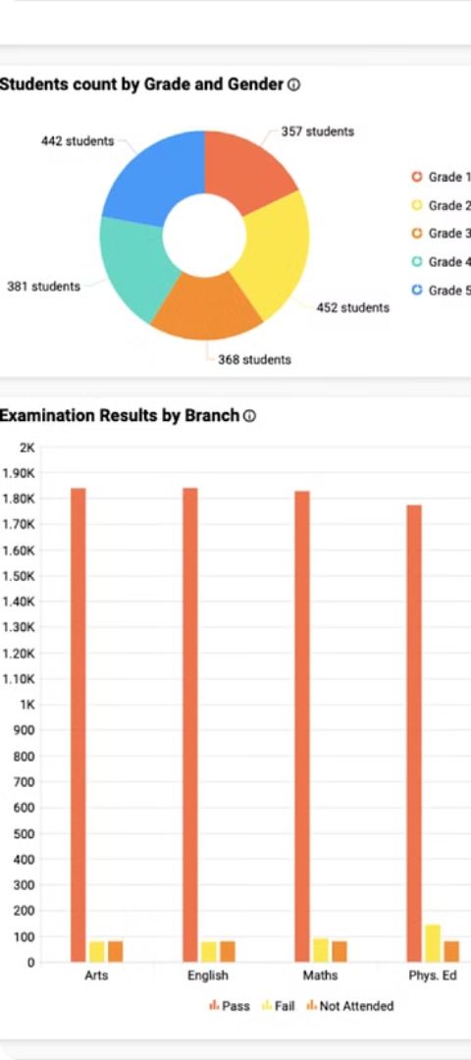
Marks Tracking and Reporting
Marks Dataframe
Detailed Feedback
The system will maintain a comprehensive Marks Dataframe, which will store the student's performance across the multiple-choice questions, descriptive questions, and the coding question. This centralized data structure will enable efficient tracking and reporting of the student's overall scores.
For the coding question, the system will provide detailed feedback, including the reasons for any deductions in marks, a review of the student's code, and a comparison of the student's output with the expected output. This feedback aims to support the student's learning and help them improve their coding skills.
Insights and Analytics
The Marks Dataframe, coupled with the detailed feedback, will enable faculty to generate comprehensive reports and analytics, providing valuable insights into student performance, areas for improvement, and the overall effectiveness of the automated grading system.

Slide 8




Ensuring Reliability and Scalability
Machine Learning
Data Security
Scalability
Continuous Improvement
The automated grading system leverages advanced machine learning algorithms to ensure accurate and consistent evaluation of student responses across different question types.
Robust data security measures are implemented to protect the confidentiality and integrity of student submissions and assessment data, safeguarding sensitive information.
The system is designed to handle increasing student volumes and cater to the growing needs of educational institutions, ensuring seamless scalability and performance.
The automated grading system is built with a focus on continuous improvement, regularly incorporating feedback and updates to enhance the user experience and the accuracy of the assessment process.

